Slide 1
Manually created/edited figures for thesis

Slide 2
1
A
2
3
B
4
C
5
6

Slide 3
1
1
1
2
2
2
1
1
1
.
.
.
.
.
.
.
.
.
N’
N’
N’
N’+1
N’+1
N’+1
N’+2
N’+2
N’+2
2
2
2
.
.
.
.
.
.
.
.
.
2N’
2N’
2N’
2N’+1
2N’+1
2N’+1
2N’+2
3
2N’+2
3
2N’+2
3
.
.
.
.
.
.
.
.
.
3N’
3N’
3N’

Slide 4
Primary routes
Extended routes (k=1)
Extended routes (k=N’)
Vehicles
Customers
Vehicles
Customers
Vehicles
Customers

Slide 5
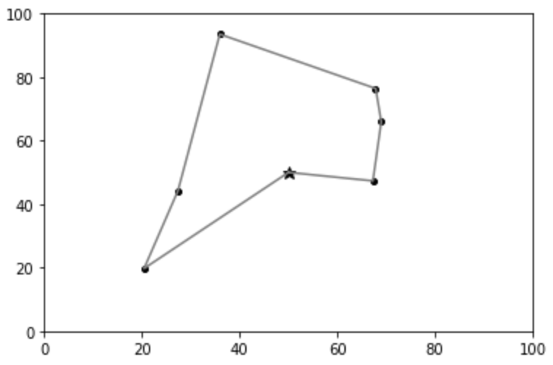

Slide 6
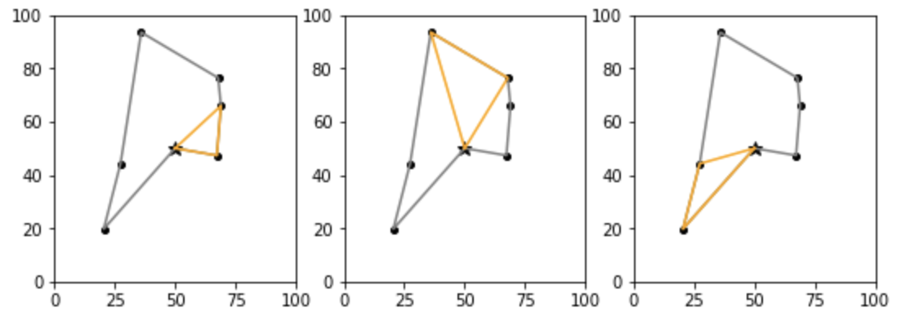
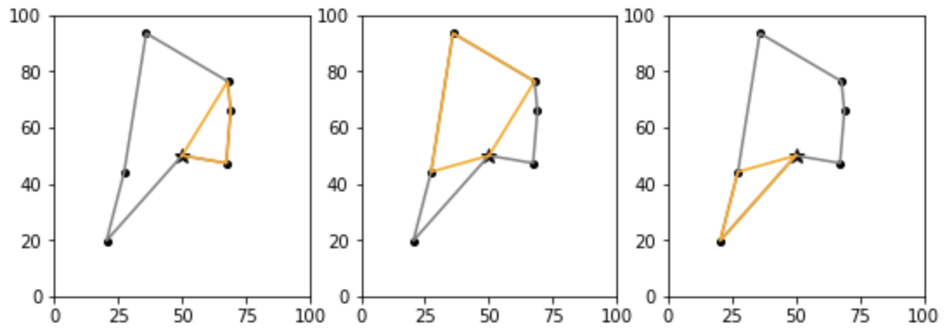
Giant tour:
4
3
2
5
1
6
Primary routes:
Extended routes:

Slide 7
Giant tour:
4
3
2
5
1
6
Primary routes:
A: {1,2}
B: {3,4}
C: {5,6}
Extended routes:
A: {1,2,3}
B: {3,4,5}
C: {5,6}

Slide 8
Primary routes:
Realized trips:
A: 11
8
3
B: 4
4
C: 9
8
1

Slide 9
Primary routes:
Realized trips:
1 (4)
3 (4)
7 (7)
A
3 (3)
1 (1)
B
7 (7)
C
1 (2)
1 (2)

Slide 10
Extended routes:
Realized trips:
1 (1)
1 (4)
3 (4)
7 (7)
A
3 (3)
5 (7)
B
2 (7)
C
2 (2)

Slide 11
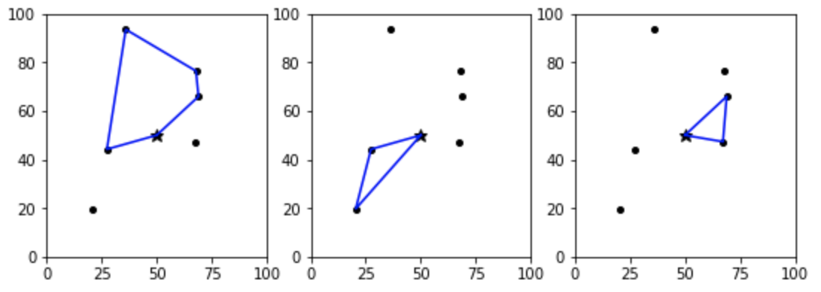
8
8
8

